Slide 1
Writing Algebraic Expressions
Miss L
Year 7

Slide 2
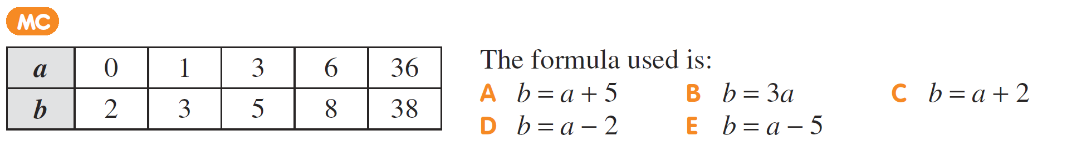

From Last Lesson

Slide 3
24
7
30
Writing Algebraic Expressions
Date
EQ – How do we write an expression?
Variable
Coefficient
Expressions
Is a letter or symbol that is used instead of a number
The number in front of a variable.
Example:
7x Coefficient is 7
6cyt Coefficient is 6
p Coefficient is 1
Made up of variables and numbers
Example:
3k – 8
6t x 5 + 4h

Slide 4
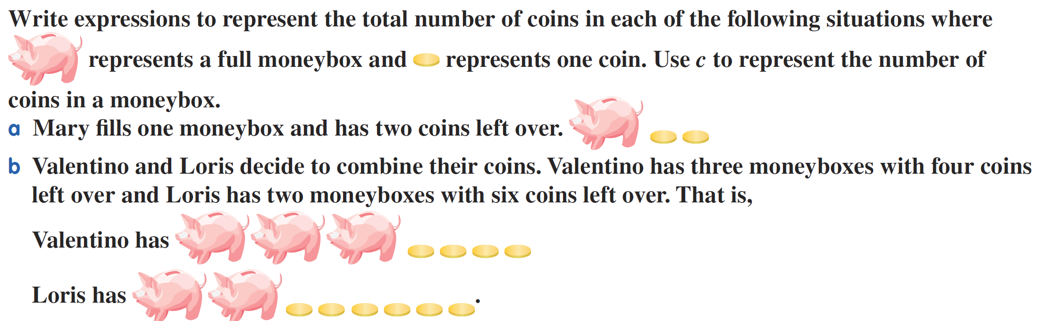
Practice
Answer: c + 2

Slide 5
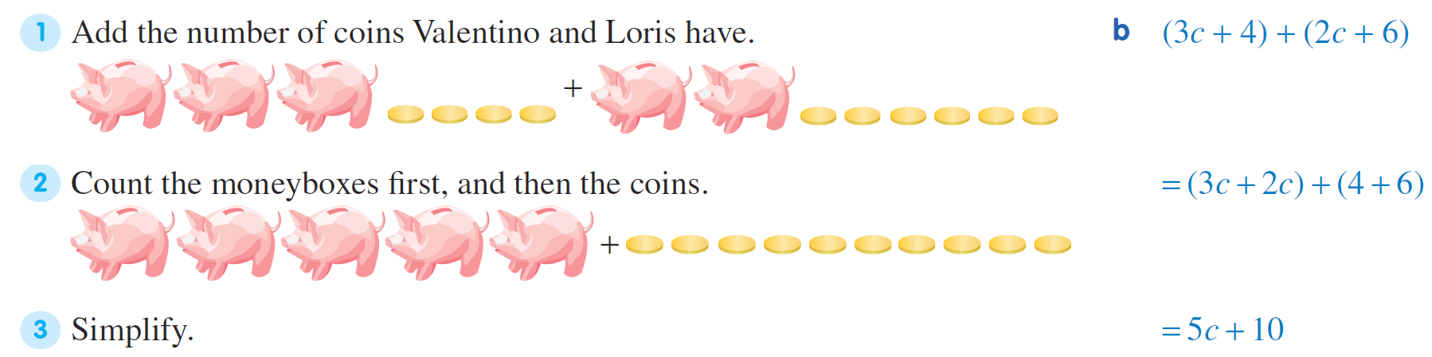
Practice

Slide 6
24
7
30
Writing Algebraic Expressions
Date
EQ – How do we write an expression?
Term
Constant
Expressions and equations are made up of terms. They are separated by + or – signs
Examples
3t
2y
drt
The value of a number cannot change. If the term only contains a number, it’s a constant.

Slide 7
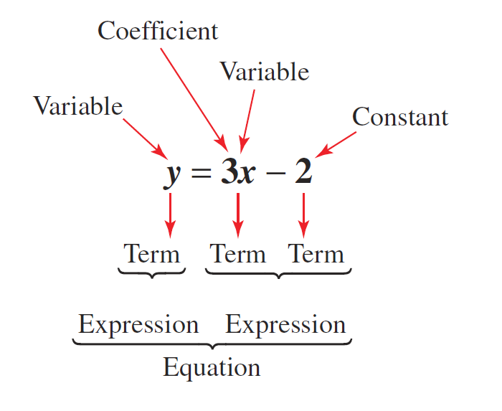

Slide 8


Slide 9
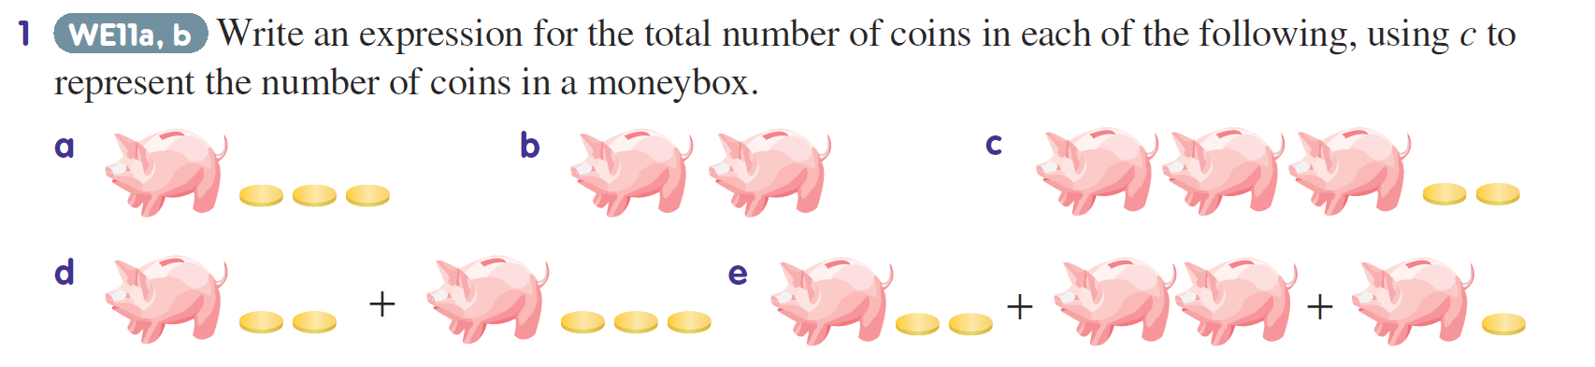
Practice

Slide 10
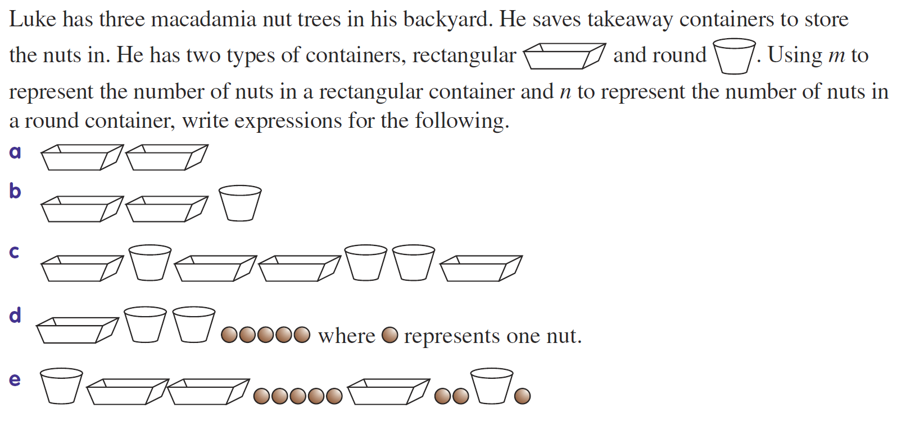
Task

